Slide 1


ShotMaster
Unleash Your Inner Cricket Maestro

Slide 2



Our Team
Md. Rayhan Islam Sefat
Reza Abdullah
Dr. Ahmedul Kabir
Roll: 1332
Roll: 1335
Associate Professor
IIT, University of Dhaka
©2024 Proprietary and Confidential. All Rights Reserved.

Slide 3

ShotMaster is a mobile application designed to help aspiring cricketers improve their batting techniques. It functions as a virtual assistant that analyzes a player's batting performance.

Slide 4
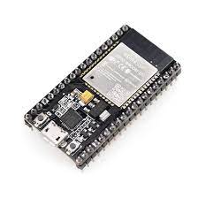
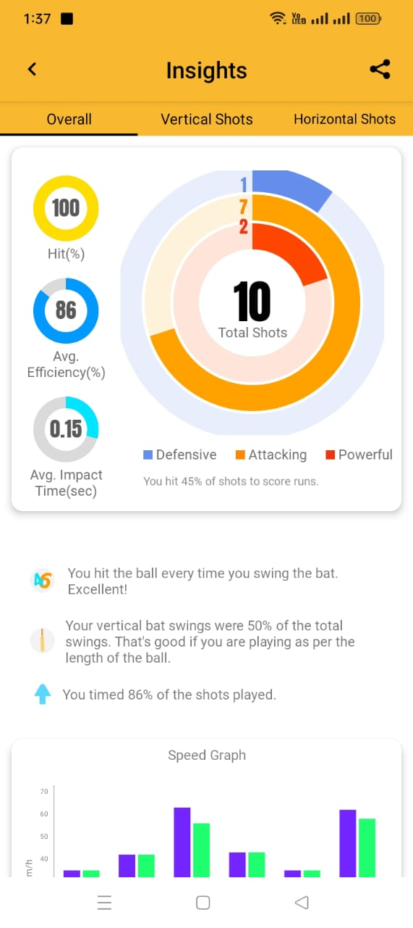
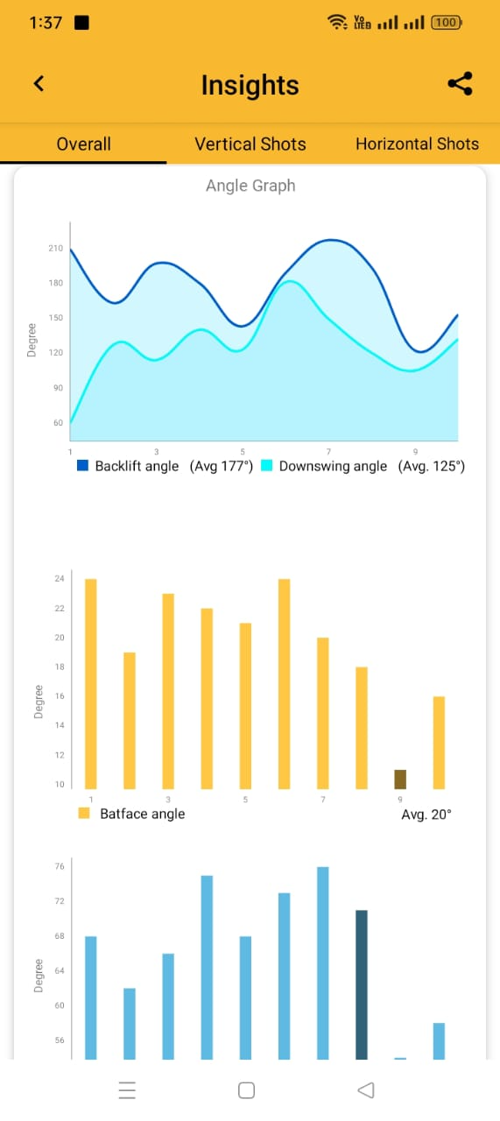
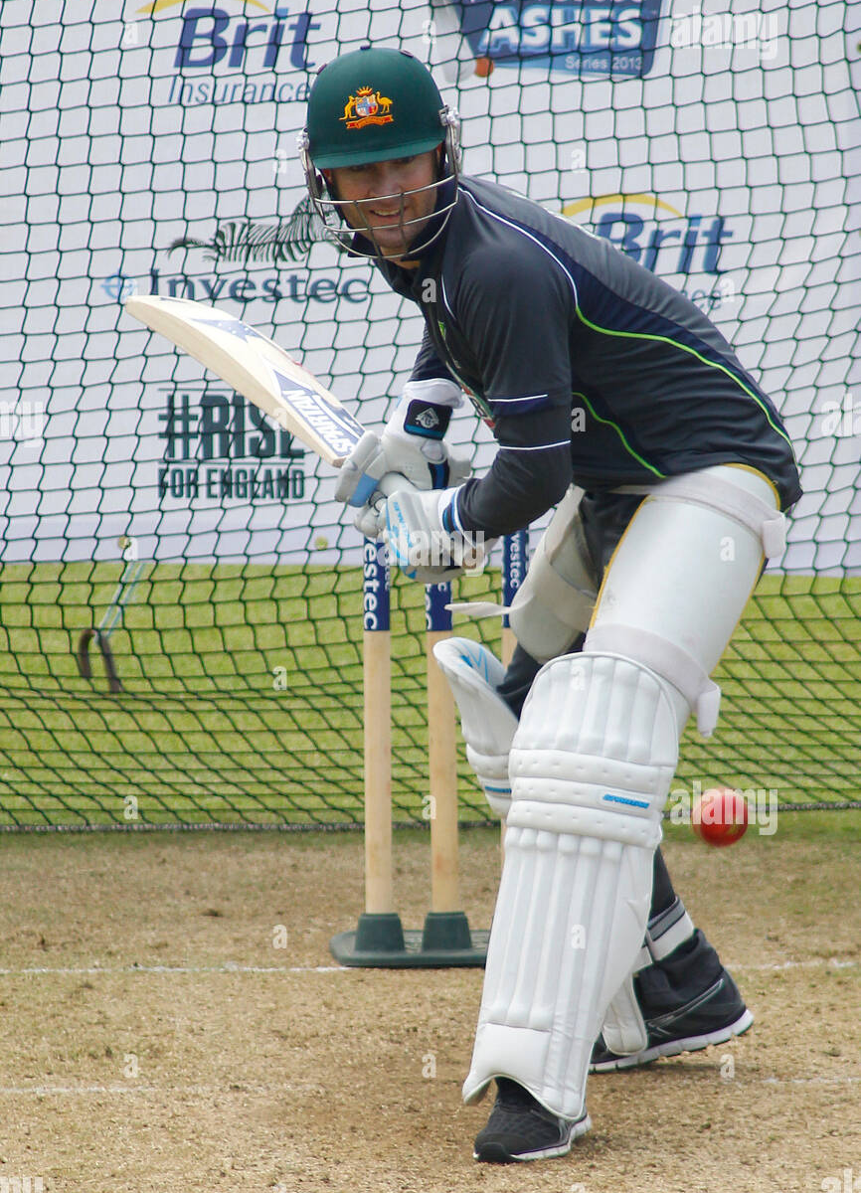
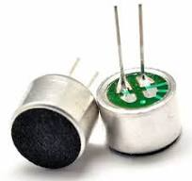
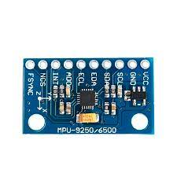
Workflow
ESP32
Microphone
MPU9250(IMU)

Slide 5

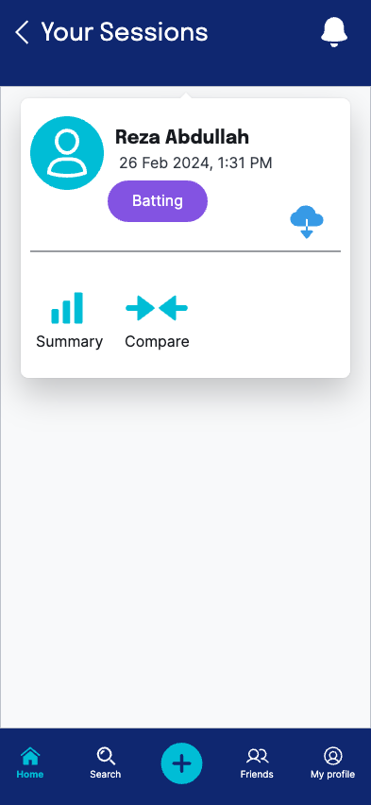
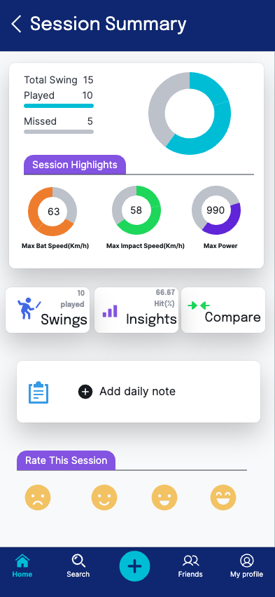
Overview

Slide 6


Stakeholders
Player
Coach

Slide 7






Quality Function Deployment(QFD)
Normal Requirements
User-friendly interface
Data recording & storage
Session Summarization
Personalized Notes
Shot-based analysis

Slide 8





Quality Function Deployment(QFD)
Expected Requirements
Sensor Integration
Improvement Graph
Connect with Coach
Multi-platform Support

Slide 9




Quality Function Deployment(QFD)
Exciting Requirements
Video analysis
AI Guidance
3D Shot Visualization

Slide 10
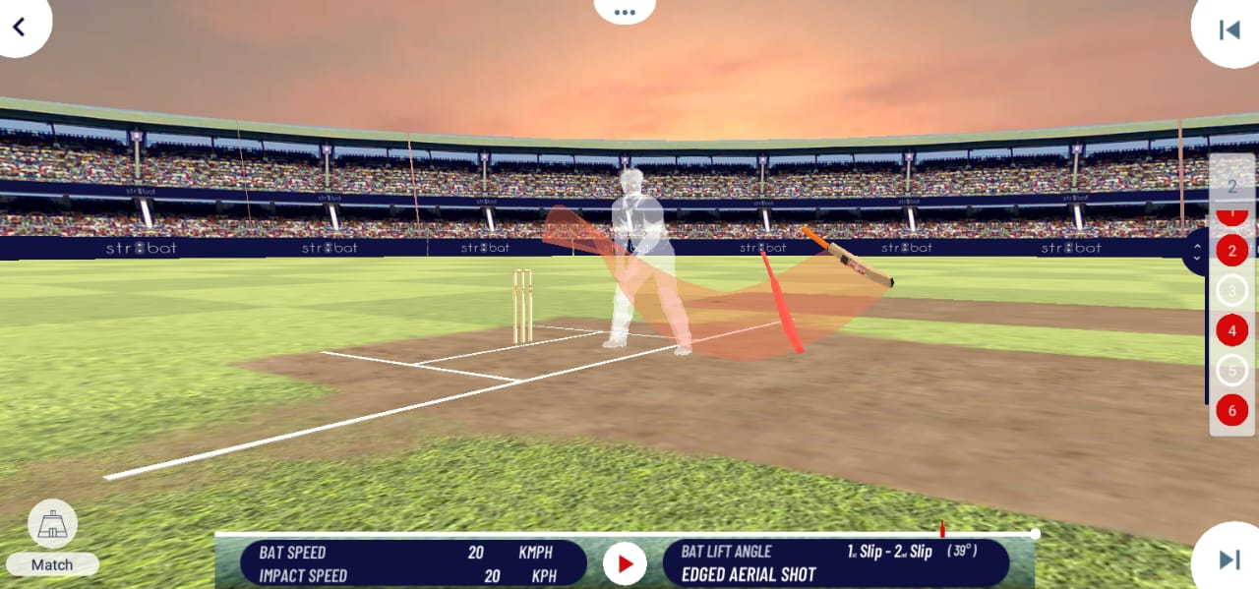
3D Shot Visualization

Slide 11
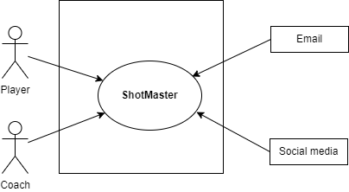
Use Case Diagram
Level 0
Fig: ShotMaster

Slide 12
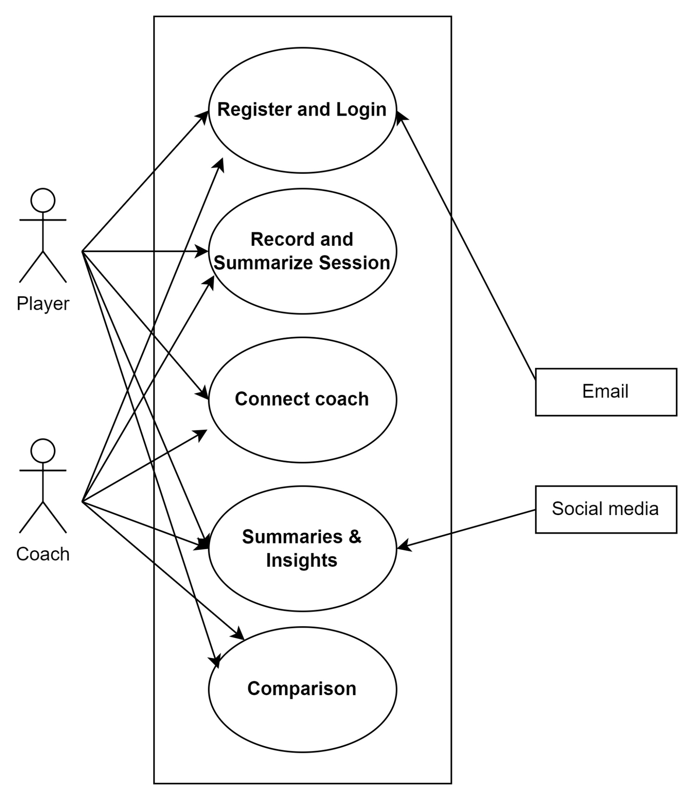
Use Case Diagram
Level 1
Fig: ShotMaster

Slide 13
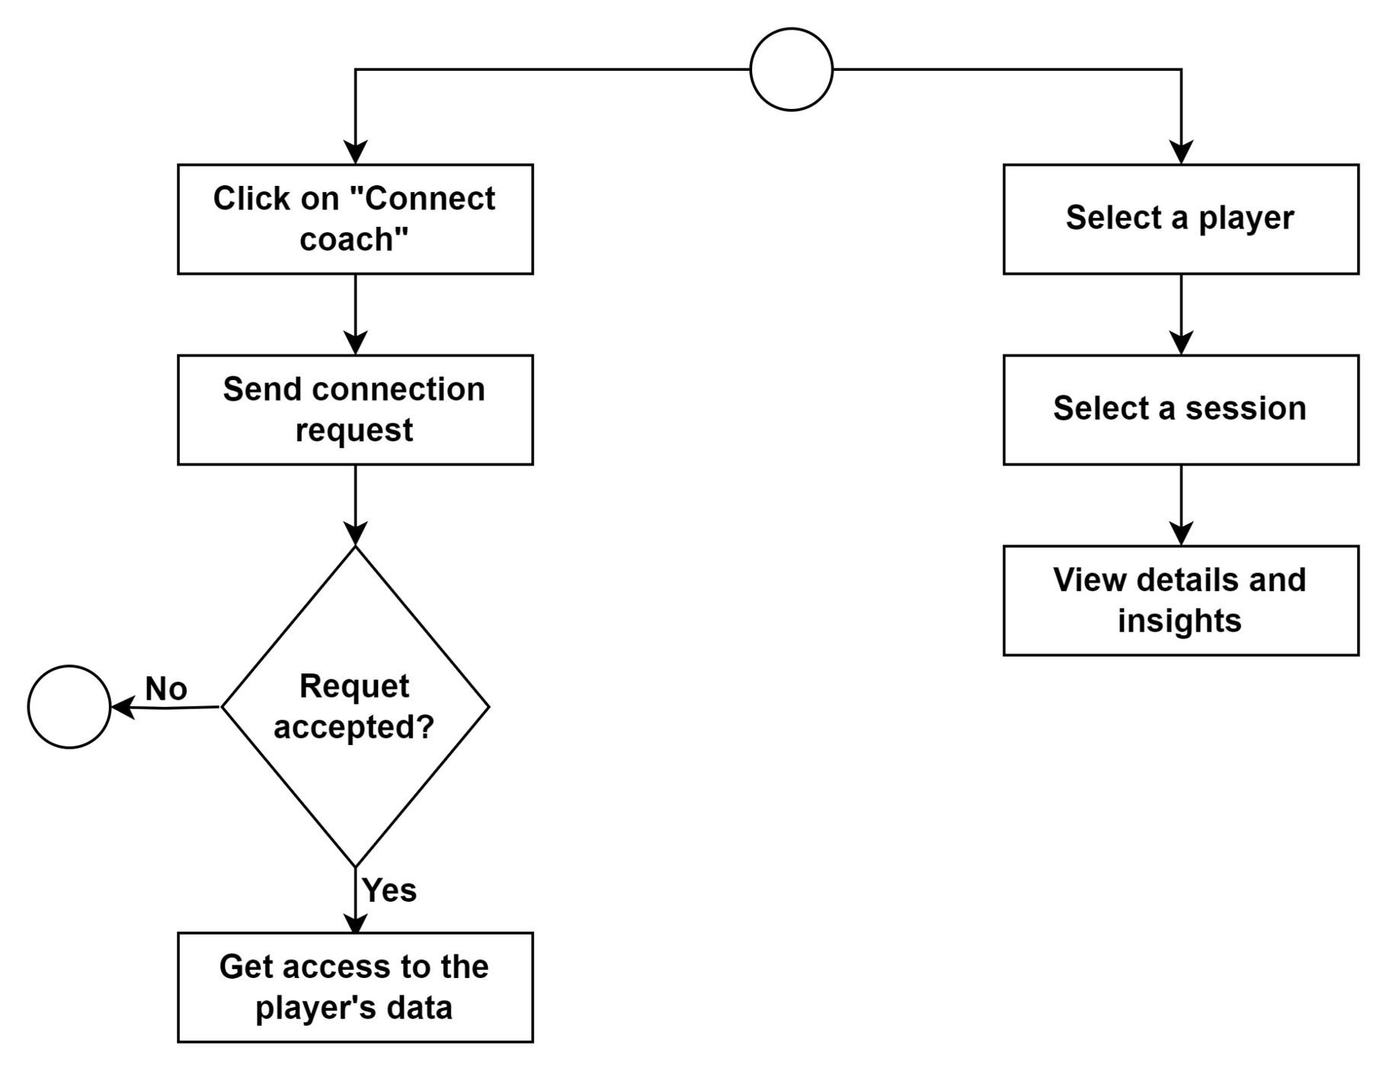
Activity Diagram
Connect Your Coach
Level 1.3
Fig: Connect Your Coach

Slide 14
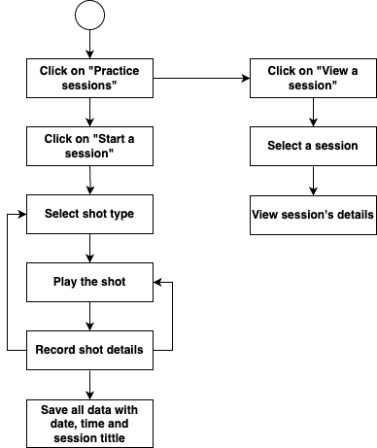
Activity Diagram
Record a Session
Level 1.2.1
Fig: Record a Session

Slide 15
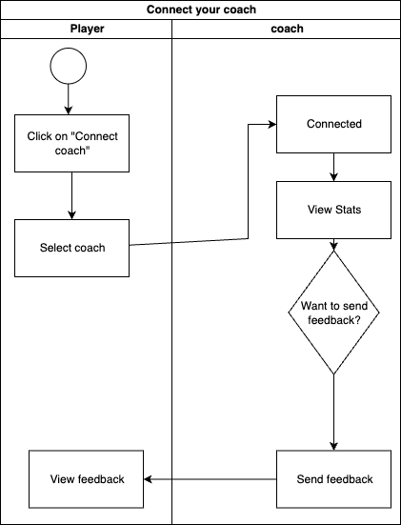
Swimlane Diagram
Connect your Coach
Level 1.3
Fig: Connect Your Coach

Slide 16
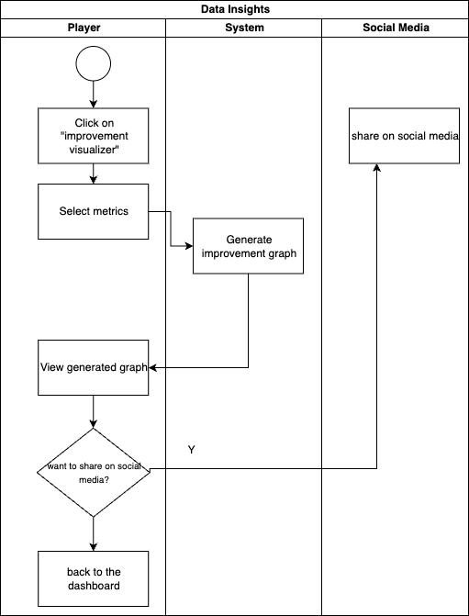
Swimlane Diagram
Data Insights
Level 1.4.2
Fig: Data Insights

Slide 17
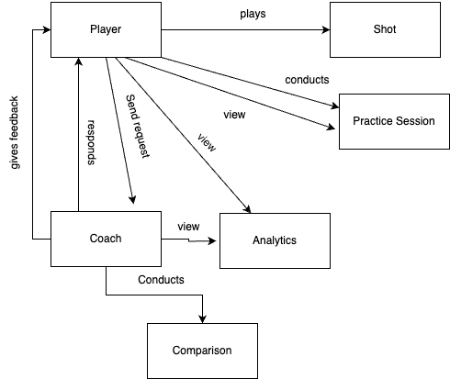
Data based Modelling
Relationship between Data Objects
Fig: Relationship between Data Objects

Slide 18
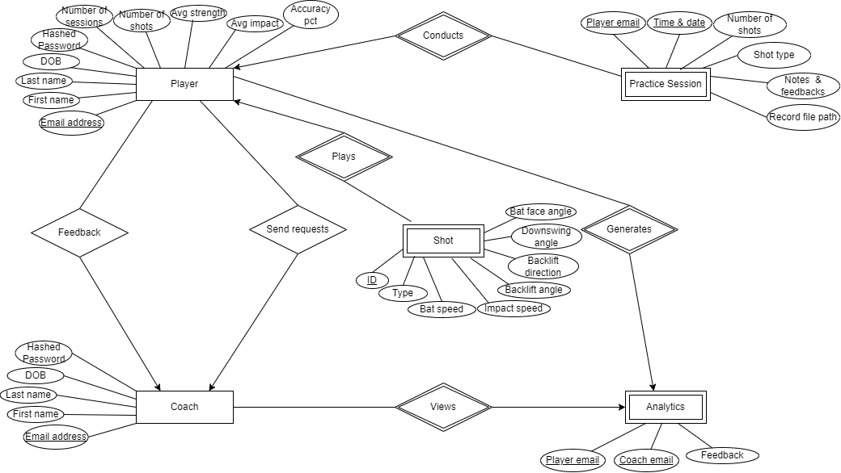
Data based Modelling
ER Diagram
Fig: ER Diagram

Slide 19
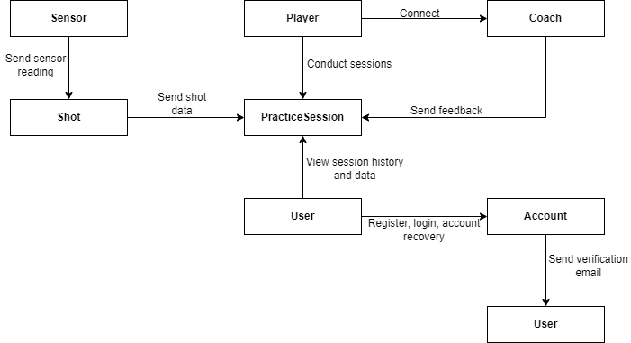
Class-based Modeling
ID-1
Fig: CRC Diagram - 1

Slide 20
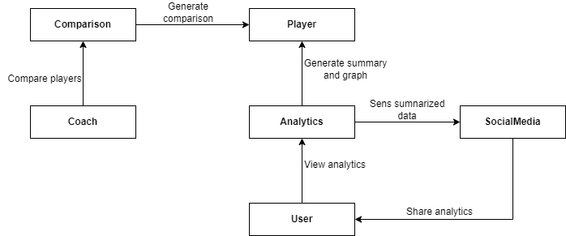
Class-based Modeling
ID-2
Fig: CRC Diagram - 2

Slide 21
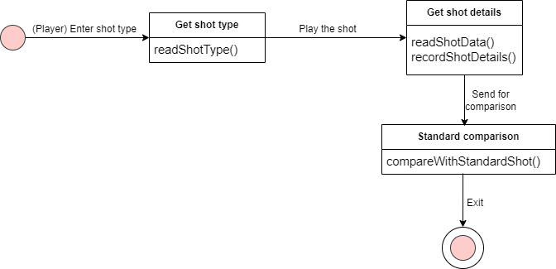
Behavior Modelling
State Transition Diagram
Class: Shot
Fig: State transition diagram of Shot

Slide 22
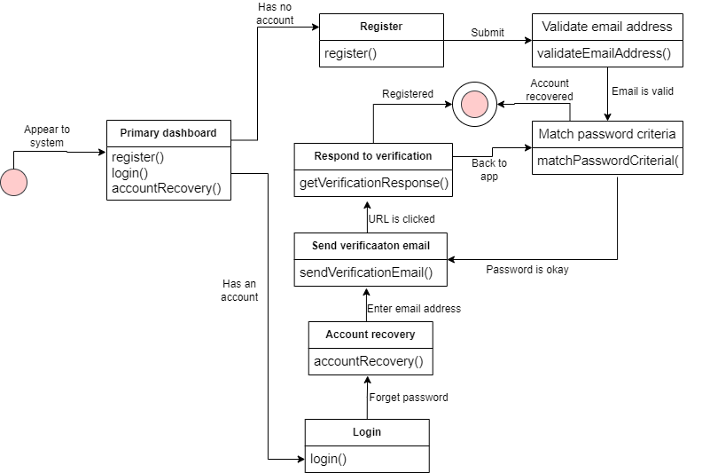
Behavior Modelling
State Transition Diagram
Class: Account
Fig: State transition diagram of Account

Slide 23
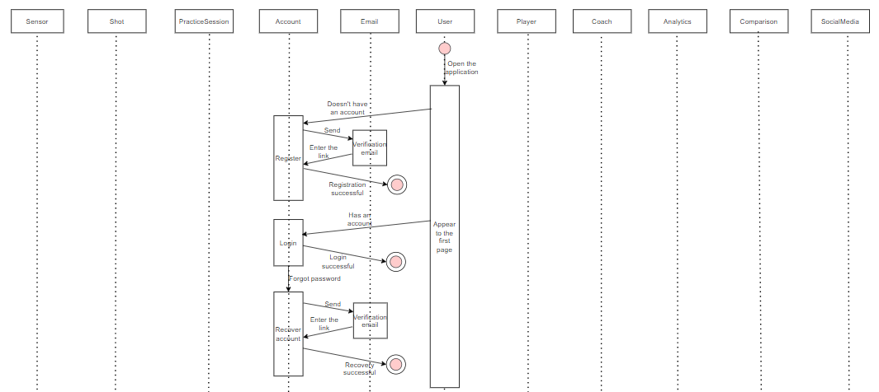
Register & Login
Sequence Diagram
Fig: Sequence diagram of Practice Session

Slide 24
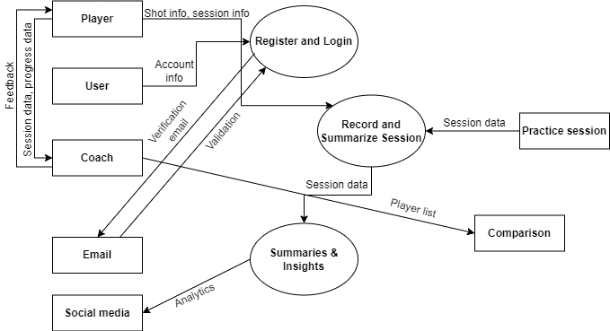
Data Flow Diagram(DFD)
ShotMaster
Fig: ShotMaster

Slide 25
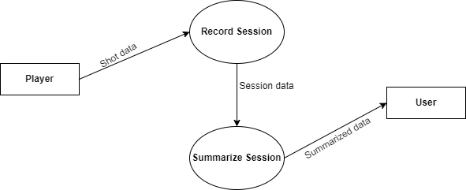
Data Flow Diagram(DFD)
Summaries and Insights
Fig: Summaries and Insights

Slide 26
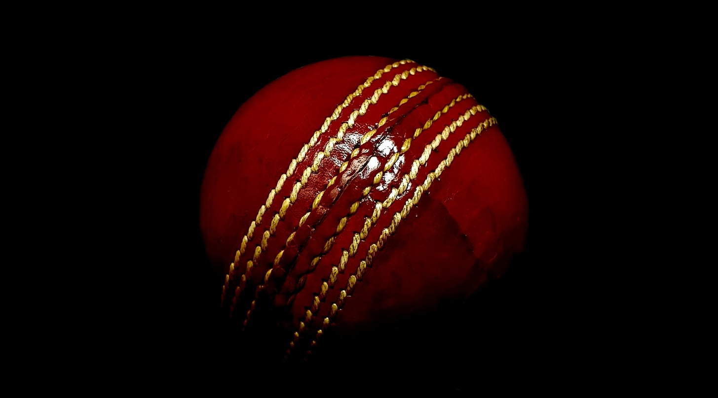
Thank you

